Slide 1
Computational Linguistics - Dependency parsing and its uses

Slide 2

What is Linguistics
the scientific study of language and its structure, including the study of grammar, syntax, and phonetics.
Source: Oxford dictionary

Slide 3
What is Computational Linguistics
the branch of linguistics in which the techniques of computer science are applied to the analysis and synthesis of language and speech.
Source: Oxford dictionary

Slide 4
What is Dependency Parsing
Syntactic structures in the text in a more machine readable format

Slide 5
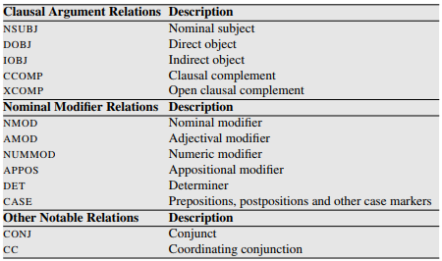
Example
Source: https://web.stanford.edu/~jurafsky/slp3/13.pdf
More: http://robotics.usc.edu/~gkoch/DependencyManual.pdf

Slide 6
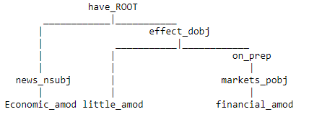
Example
Economic news have little effect on financial markets

Slide 7
Areas of Application
Text Classification
Information Extraction
Information Retrieval
Machine Translation
Question Answering

Slide 8
Relevant Papers
Syntactic N-grams as Machine Learning Features for Natural Language Processing http://www.cic.ipn.mx/~sidorov/Synt_n_grams_ESWA_FINAL.pdf
Dependency-Based Open Information Extraction
http://www.anthology.aclweb.org/W/W12/W12-0702.pdf
Query Understanding Enhanced By Hierarchical Parsing Structures
https://groups.csail.mit.edu/sls/publications/2013/Liu_ASRU_2013.pdf
Dependency Structure Trees in Syntax Based Machine Translation
http://www.cs.cmu.edu/~vamshi/publications/DependencyMT_report.pdf
Question Answering Passage Retrieval Using Dependency Relations
https://www.comp.nus.edu.sg/~kanmy/papers/f66-cui.pdf

